Slide 1
ANSYS Macro Vision
Benjamin Guest

Slide 2
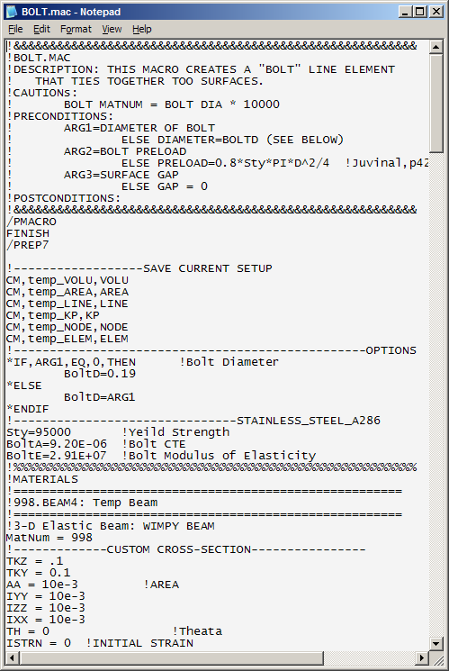
What Are ANSYS Macros?
A text file containing a series of ANSYS command
File ends with .mac
Similar to existing ANSYS batch files you might use using “/input,<somefile>,txt”

Slide 3
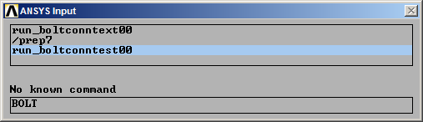
What Are ANSYS Macros?
Can be called from
  ANSYS command line
  a batch file
  Another macro.
Called using just the macro name w/o the .mac (See below)

Slide 4
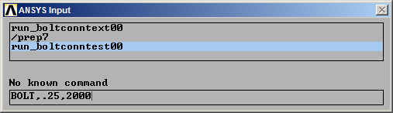
What Are ANSYS Macros
Macros can include arguments to add functionality to the macro
  For Example: in the BOLT macro below
    Argument 1 specifies a .25” bolt diameter
    Argument 2 specifies a bolt preload of 2000 lbf

Slide 5
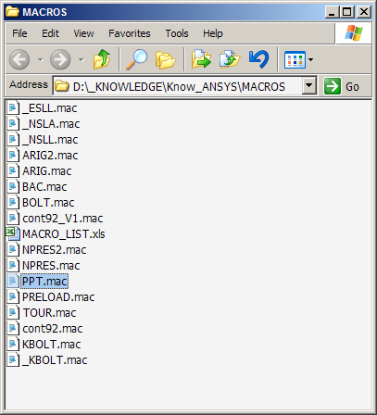
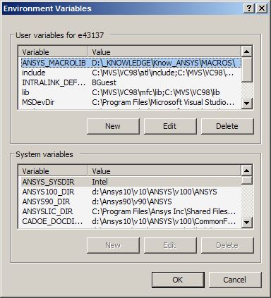
How to set up computer for Macros
1) Create a folder for your macros
2) Create ANSYS_MACROLIB environmental variable with the path of your macro
  You can reference several macro directories, see ANSYS help files

Slide 6
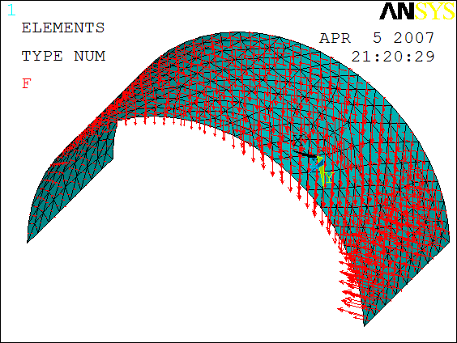
My macros: NPRES
Creates “Pressure” distribution on shell surface based on element location.
Area must already be meshed with triangular shell elements with mid-side nodes
Let me know if you need a similar tool, I can morph NPRES to suit your needs

Slide 7
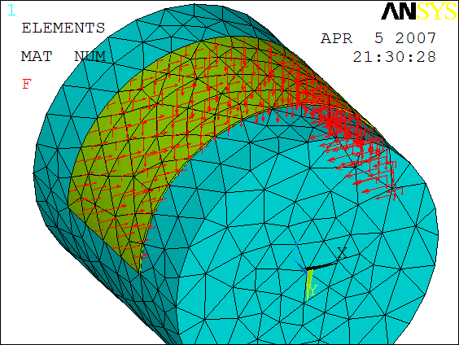
My macros: NPRES2
Creates “Pressure” distribution the surface of a volume based on surface location
Volume be meshed with tet-elements with mid-side nodes
Let me know if you need a similar tool, I can morph NPRES2 to suit your needs

Slide 8
Other Macros
See __BensMacros.xls
There are a lot of them, let me know if you are looking for something, there’s a good chance it already exists.

